Slide 1
ChicagoKUG – Many Types of AI
Thomas Nield
6/25/2019

Slide 2
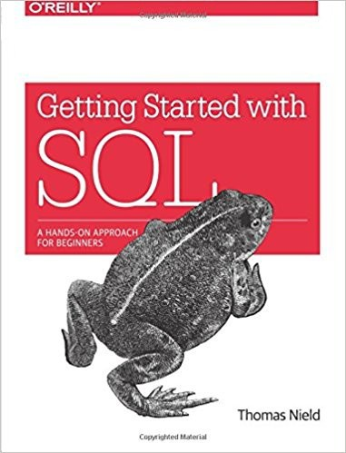
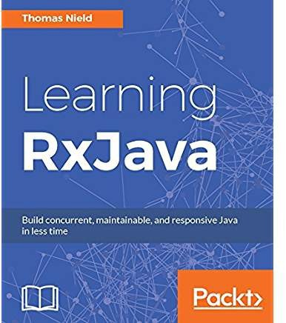
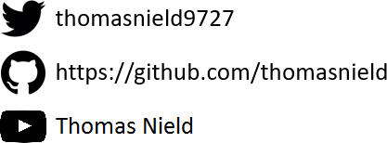
Thomas Nield
Business Consultant, Operations Research, Network Planning at Southwest Airlines
Author
Getting Started with SQL by O'Reilly
Learning RxJava by Packt
Trainer and content developer at O’Reilly Media
2

Slide 3
The Monty Hall Problem

Slide 4







The Monty Hall Problem
DOOR 1
DOOR 2
DOOR 3
Choose a door, one has a prize. Two others have goats.
4

Slide 5


The Monty Hall Problem
DOOR 1
DOOR 2
DOOR 3
You choose Door 1.
What is the probability it has the prize?
5

Slide 6


The Monty Hall Problem
DOOR 1
33.33%
DOOR 2
33.33%
DOOR 3
33.33%
You choose Door 1.
What is the probability it has the prize? 33%
6

Slide 7

The Monty Hall Problem
DOOR 1
DOOR 2
Twist! Door 3 was just opened. It’s a goat.
Did you want to switch from Door 1 to Door 2?
7

Slide 8
The Monty Hall Problem
DOOR 1
?%
DOOR 2
?%
What is the prize probability of each door now?
8

Slide 9

The Monty Hall Problem
DOOR 1
?%
DOOR 2
?%
HINT: The prize probability of either door is not 50%

Slide 10


The Monty Hall Problem
DOOR 1
33.33%
DOOR 2
66.66%
The probability of Door 1 is 33.33% while Door 2 is now 66.66%. You should switch! But why?

Slide 11
The Monty Hall Problem
33.33%
66.66%
33.33%

Slide 12
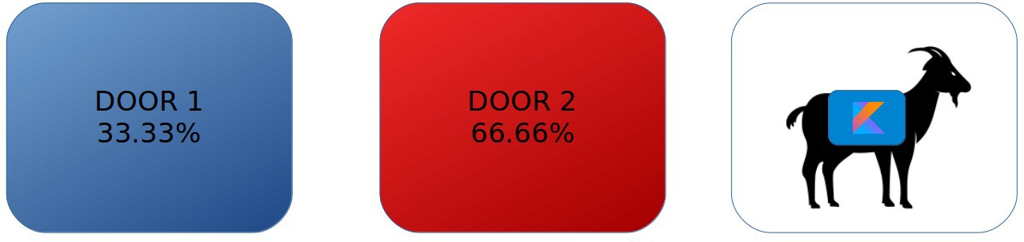
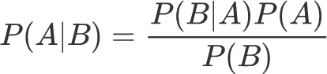
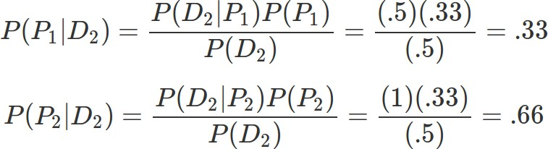
The Monty Hall Problem
According to Bayes Theorem...

Slide 13
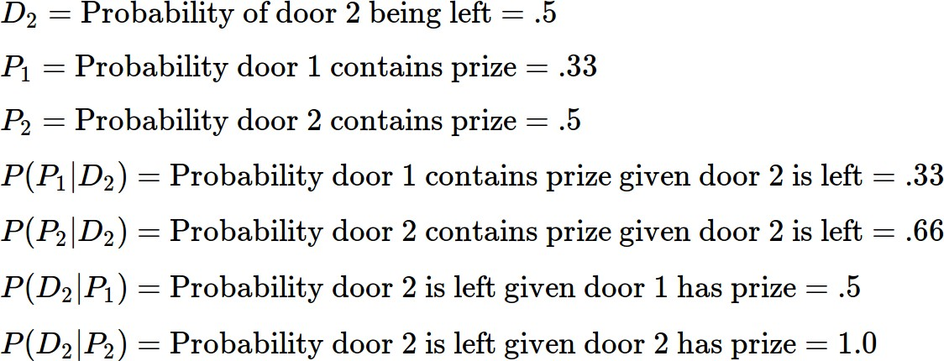
The Monty Hall Problem

Slide 14






































































































































The Monty Hall Problem
Still confused? Hyperbolize! Imagine you had 1000 doors, and you chose Door #19.
19

Slide 15


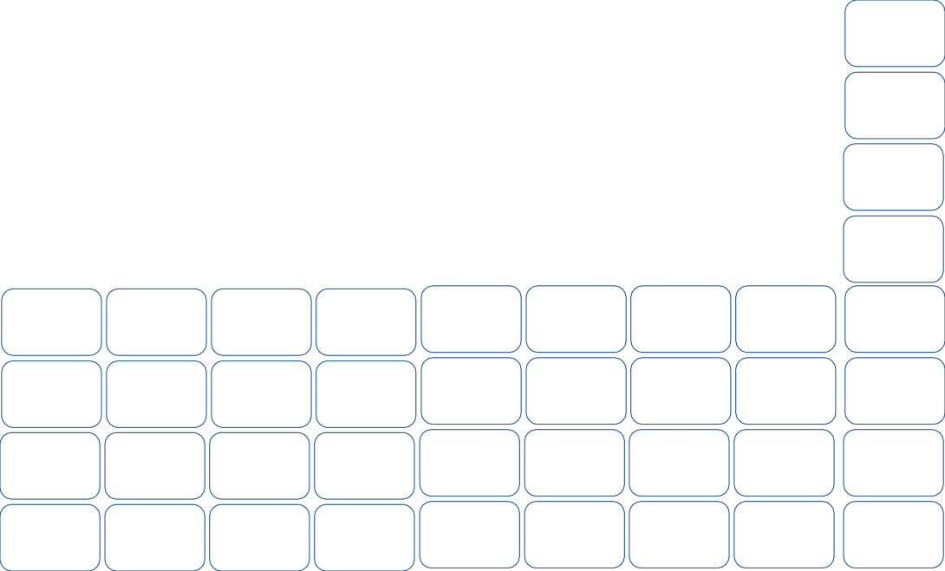



The Monty Hall Problem
All other doors are opened but yours and Door #77. Inclined to switch now?
19
77

Slide 16
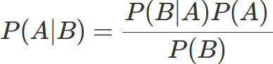

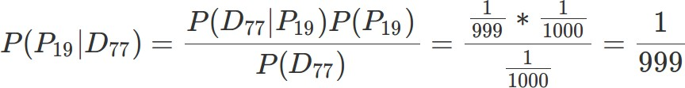
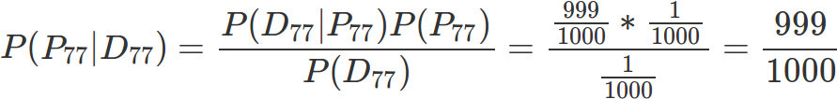


The Monty Hall Problem
#19
#77
Yes, you should switch!

Slide 17
Monty Hall Simulation
Monte Carlo simulation of the Monty Hall Problem
https://gist.github.com/thomasnield/95443be4d5255929a0d716933df29de7

Slide 18
Why Am I Showing This?
The Monty Hall problem encapsulates the critical (and misunderstood) nuances of probability.
Sometimes we only have incomplete data, but we need to make a decision anyway.
When new partial data is available, we must merge (not abandon) the data we previously had.
Businesses often want certainty and exactness.
But the valuable, high-profile problems today often tackle uncertainty and approximation.
Users and businesses expect “smarter” applications that will predict what they want. Machine learning and optimization is nondeterministic and unavoidably has error.
Many search spaces are too large to exhaustively explore.

Slide 19
What Is Mathematical Optimization?
Optimization is a space of algorithms that tries to find a feasible or optimal solution to a constrained problem.
Scheduling classrooms, staff, transportation, sports teams, and manufacturing Finding an optimal route for vehicles to visit multiple destinations
Optimizing manufacturing operations
Solving a Sudoku
Minimizing loss for a machine learning algorithm
Mathematical optimization is a mixed bag of algorithms and techniques, which can be built from scratch or with the assistance of a library.

Slide 20
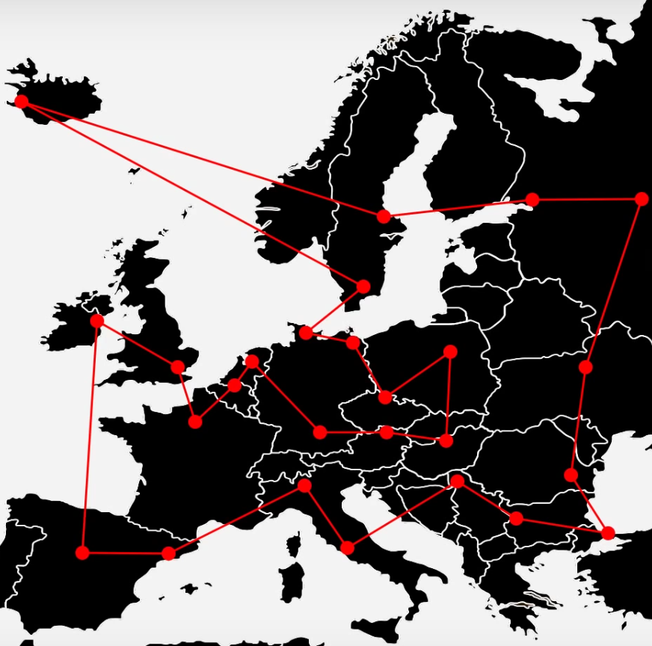
Traveling Salesman Problem
The Traveling Salesman Problem (TSP) is one of the most elusive and studied computer science problems since the 1950’s.
Objective: Find the shortest round-trip tour across several geographic points/cities.
The Challenge: Just 60 cities = 8.3 x 10⁸¹ possible tours
That’s more tour combinations than there are observable atoms in the universe!

Slide 21

Metaheuristic – Hill Climbing
Start with a random solution, even if it is poor quality.
Repeat the following steps for a number of iterations and/or until the solution cannot improve anymore.
Select a random part of the solution and change it.
If that results in an improvement, keep it.
Easy, right? But there is a problem…

Slide 22
Tour Distance
Tour Configurations

Slide 23
LOCAL MINIMUM
Tour Distance
GLOBAL MINIMUM
Tour Configurations

Slide 24
Tour Distance
Tour Configurations

Slide 25
Tour Distance
Tour Configurations

Slide 26
Tour Distance
Greedy algorithm gets stuck
Tour Configurations

Slide 27
Tour Distance
We really want to be here
Tour Configurations

Slide 28
Tour Distance
Or even here
Tour Configurations

Slide 29
Tour Distance
How do we escape?
Tour Configurations

Slide 30
Tour Distance
Make me slightly less greedy!
Tour Configurations

Slide 31
Tour Distance
Occasionally allow a marginally inferior move...
Tour Configurations

Slide 32
Tour Distance
To find superior solutions!
Tour Configurations

Slide 33
Tour Distance
To find superior solutions!
Tour Configurations

Slide 34
Simulated Annealing
Simulated annealing is another metaheuristic similar to hill-climbing, but it periodically allows inferior moves hoping it will lead to better solutions.
It can be surprisingly versatile, and used to optimize problems ranging from the Traveling Salesman to tuning neural networks.
So how do you determine whether to keep an inferior move?
A temperature schedule throttles periodically between greediness (don’t accept an inferior move) and randomness (accept an inferior move).
A given temperature on the given iteration will result in a weighted coin flip, and that coin flip will determine whether the inferior move is accepted or not.

Slide 35
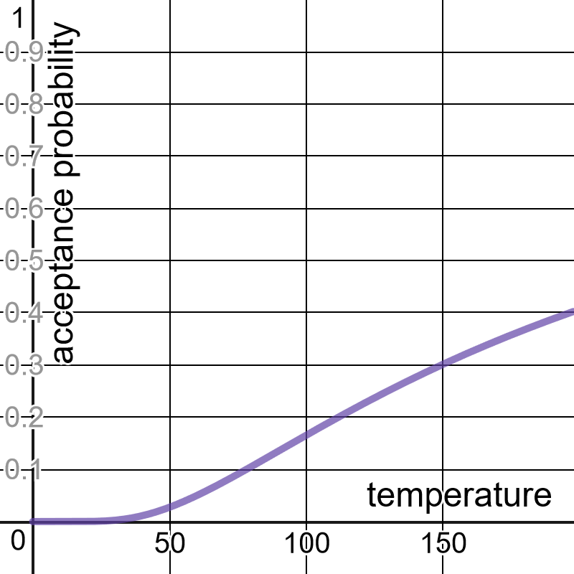
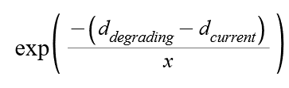
Calculating the Weighted Coin Flip Probability
Where x is a given temperature, here is how to convert it into a probability of accepting an inferior move.
d_{degrading} and d_{current} reflect the inferior distance and current distance of the move respectively.
https://www.desmos.com/calculator/rpfpfiq7ce

Slide 36

Metaheuristic – Simulated Annealing
Start with a random solution, even if it is poor quality.
At each given temperature/iteration, do the following steps:
Select a random variable in the solution and change it.
If that results in an improvement, keep it.
If the result is inferior, flip a weighted coin based on the temperature and degradation of the move to determine whether to keep it.
If your solution is not acceptable, modify your temperature schedule and try again.

Slide 37
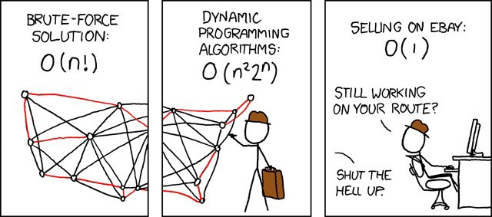
Source Code
Traveling Salesman Demo https://github.com/thomasnield/traveling_salesman_demo
Traveling Salesman Plotter https://github.com/thomasnield/traveling_salesman_plotter
SOURCE: xkcd.com

Slide 38
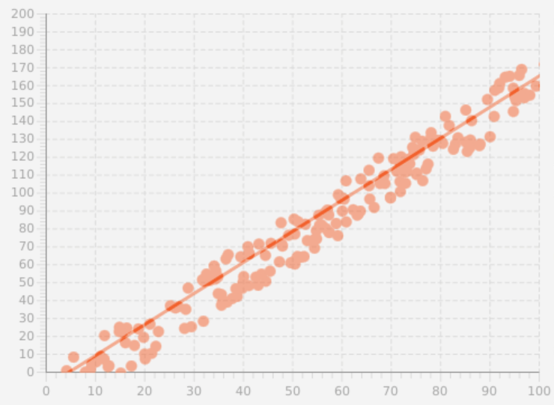
Metaheuristics for Linear Regression
Let’s use hill climbing/simulated annealing for a simple problem with continuous variables: linear regression.
A simple linear regression fits a line of the form y = mx + b, where we find the best m and b values that fit the points, minimizing the sum of least squared differences.
Note: For an intuitive graph demonstration sum of least squares fitting: https://www.desmos.com/calculator/lywhybetzt

Slide 39
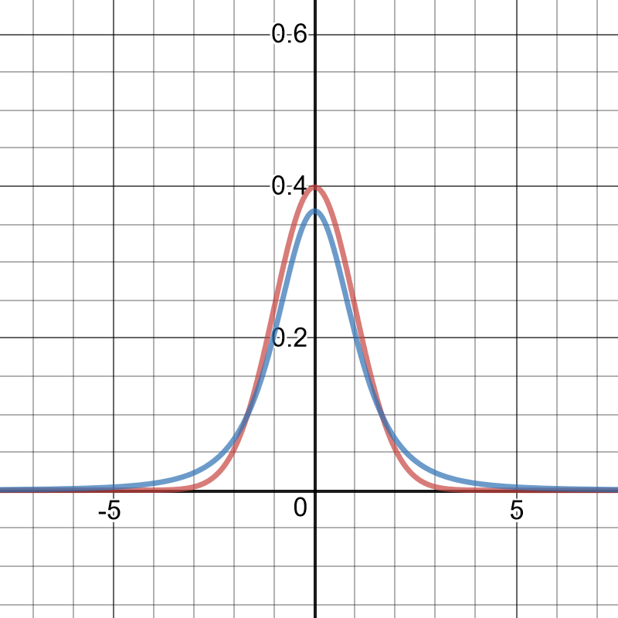
Metaheuristics for Linear Regression
Since they are continuous and not discrete, how do we randomly change values for m or b?
We randomly increase/decrease m and b with random values from a standard normal distribution, or even better a T-Distribution which has fatter tails.
Fatter tails = more smaller/larger values = more diverse moves.
We can use these random adjustments to m and b as our moves in hill climbing and simulated annealing.
Normal Distribution
T- Distribution
https://www.desmos.com/calculator/xm56tvvalh

Slide 40
Metaheuristics for Quantile Regression
What’s cool about building search algorithms is we can pursue weird, niche, and even nonlinear objectives often needed in real-world problems, even if we don’t know how to mathematically implement them.
This may not yield the most efficient or precise approach, but it can be effective nonetheless.
For example, quantile regression is just like linear regression, but it puts a percentage of points under the line.
If you want 80% of the point to fall under the line, you can quickly build a search algorithm seeking that objective rather than having to deep dive into niche Calculus concepts.

Slide 41
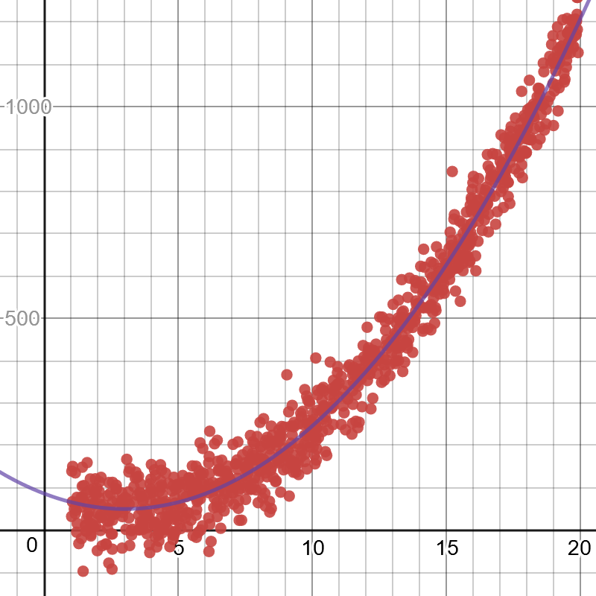
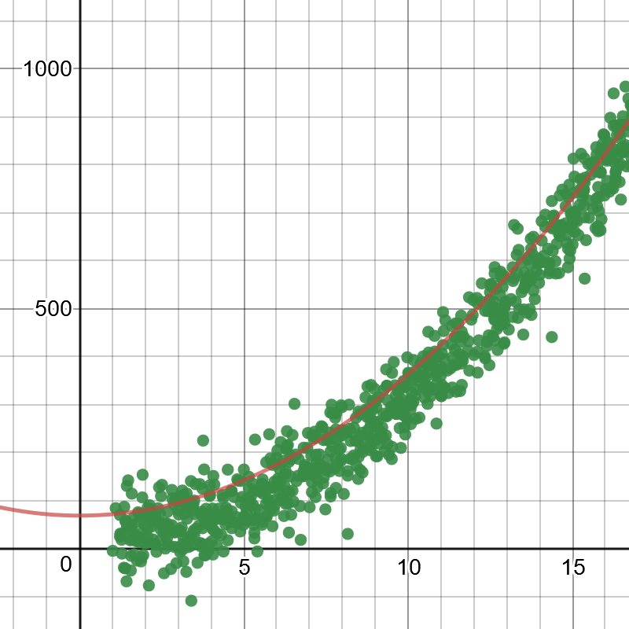
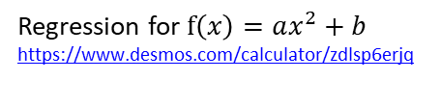
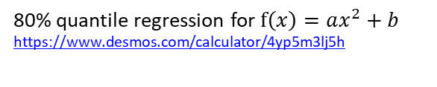
Use Metaheuristics for Nonlinear Regressions Too!
Python Code:
https://bit.ly/2VQAjnn
Regression for $f\left(x\right)=ax^{2}+b$
https://www.desmos.com/calculator/zdlsp6erjq
80% quantile regression for $f\left(x\right)=ax^{2}+b$
https://www.desmos.com/calculator/4yp5m3lj5h

Slide 42
Other Metaheuristics Algorithms
Hill Climbing and Simulated Annealing are practical workhorses for a lot of optimization problems
There are many other metaheuristics algorithms, some of which you might have heard of:
Genetic algorithms
Tabu search
Ant colony optimization
Evolutionary algorithms
K-Opt
Go down the rabbit hole: https://en.wikipedia.org/wiki/Metaheuristic

Slide 43
Using Randomness for Simulation
You may be familiar with random number generators
When any number is equally likely to be generated, this is known as a Uniform
distribution
But what if we wanted some numbers to be generated more likely than others?
This can be a powerful tool and can be used to create simulations.

Slide 44
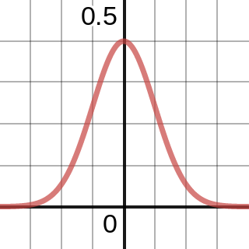
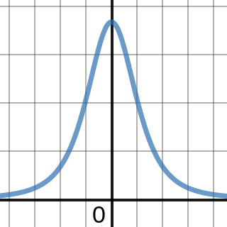
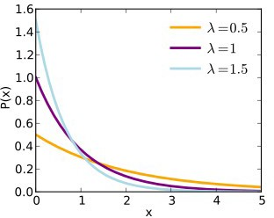
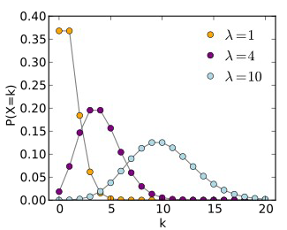
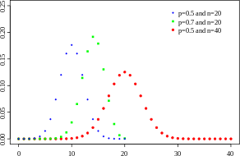
Some Useful Distributions
Normal
T-Distribution
Exponential
Poisson
Binomial
Learn More:
https://www.coursera.org/learn/introductiontoprobability

Slide 45
Generating a Schedule
You need to generate a schedule for a single classroom with the following classes:
Psych 101 (1 hour, 2 sessions/week)
English 101 (1.5 hours, 2 sessions/week)
Math 300 (1.5 hours, 2 sessions/week)
Psych 300 (3 hours, 1 session/week)
Calculus I (2 hours, 2 sessions/week) Linear Algebra I (2 hours, 3 sessions/week) Sociology 101 (1 hour, 2 sessions/week)
Biology 101 (1 hour, 2 sessions/week)
Supply Chain 300 (2.5 hours, 2 sessions/week)
Orientation 101 (1 hour, 1 session/week)
Available scheduling times are Monday through Friday, 8:00AM-11:30AM, 1:00PM-5:00PM Slots are scheduled in 15 minute increments.

Slide 46
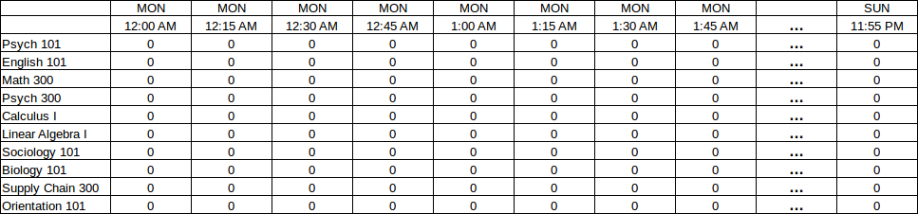
Generating a Schedule
Visualize a grid of each 15-minute increment from Monday through Sunday, intersected with each possible class.
Each cell will be a 1 or 0 indicating whether that’s the start of the first class.

Slide 47
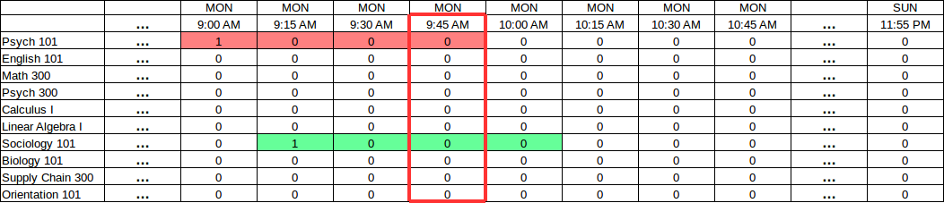
Generating a Schedule
Next visualize how overlaps will occur.
Notice how a 9:00AM Psych 101 class will clash with a 9:15AM Sociology 101.
We can sum all blocks that affect the 9:45AM block and ensure they don’t exceed 1.
Sum of affecting slots = 2 FAIL, sum must be <=1

Slide 48
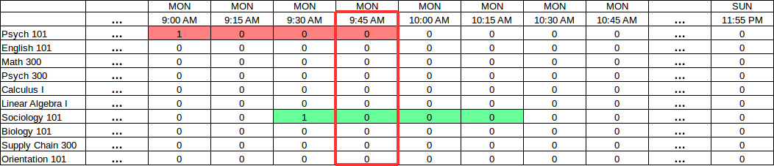
Generating a Schedule
Next visualize how overlaps will occur.
Notice how a 9:00AM Psych 101 class will clash with a 9:30AM Sociology 101.
We can sum all blocks that affect the 9:45AM block and ensure they don’t exceed 1.
Sum of affecting slots = 2 FAIL, sum must be <=1

Slide 49
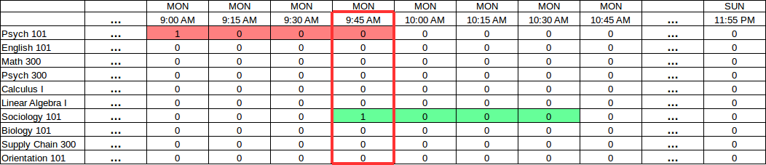
Generating a Schedule
Next visualize how overlaps will occur.
Notice how a 9:00AM Psych 101 class will clash with a 9:45AM Sociology 101.
We can sum all blocks that affect the 9:45AM block and ensure they don’t exceed 1.
Sum of affecting slots = 2 FAIL, sum must be <=1

Slide 50
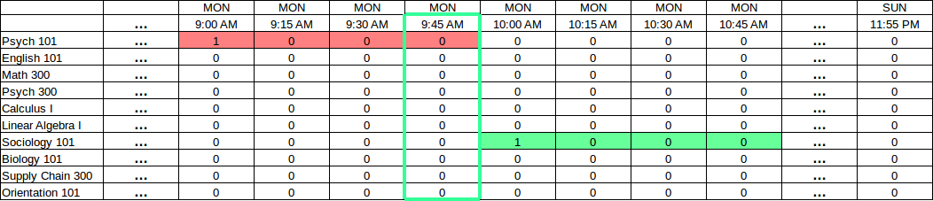
Generating a Schedule
If the “sum” of all slots affecting a given block are no more than 1, then we have no conflicts!
Sum of affecting slots = 1 SUCCESS!

Slide 51
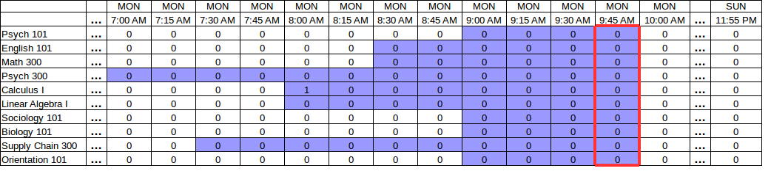
Generating a Schedule
For every “block”, we must sum all affecting slots (shaded below) which can be identified from the class durations.
This sum must be no more than 1.

Slide 52
Generating a Schedule
Taking this concept even further, we can account for all recurrences.
The “affected slots” for a given block can query for all recurrences for each given class.
View image here.

Slide 53
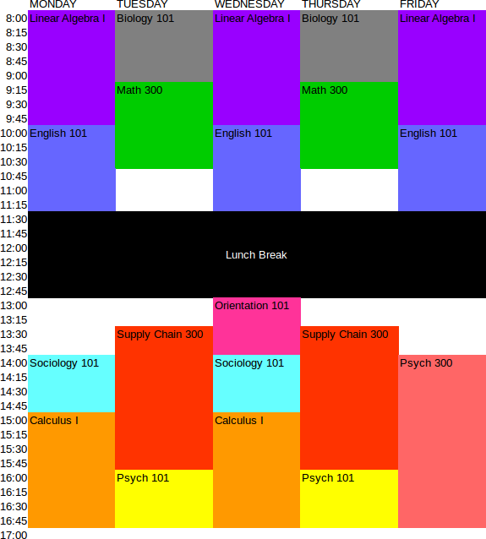
Generating a Schedule
Plug these variables and feasible constraints into the optimizer or a tree search algorithm (which I’ll show next), and you will get a solution.
Most of the work will be finding the affecting slots for each block.

Slide 54
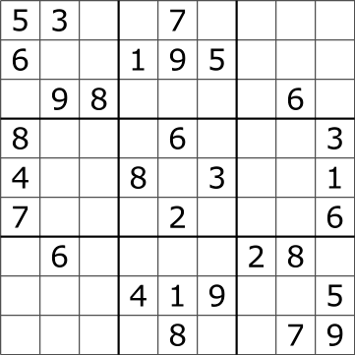
Hold that Thought,
Let’s Talk About State Space Search
Imagine you are presented a Sudoku.
Rather than do an exhaustive brute-force search, think in terms of constraint programming to reduce the search space.
First, sort the cells by the count of possible values they have left:

Slide 55
Solving a Sudoku
[4,4] → 5
[7,7] → 3
[8,6] → 4
[1,4] → 2, 5
[0,7] → 2, 3
[3,2] → 2, 3
[4,2] → 3, 4
[5,2] → 2, 4
[3,5] → 5, 9
[5,5] → 1, 4
[4,6] → 3, 5
[5,8] → 2, 6
[6,7] → 3, 6
[2,6] → 1 , 7
[0,2] → 1, 2, 3
[1,3] → 1, 2, 5
…
[2,6] → 1,3,4,5,7,9
0 1 2 3 4 5 6 7 8
0
1
2
3
4
5
6
7
8
Put cells in a list sorted by possible candidate count

Slide 56
Solving a Sudoku
[4,4] → 5
[7,7] → 3
[8,6] → 4
[1,4] → 2, 5
[0,7] → 2, 3
[3,2] → 2, 3
[4,2] → 3, 4
[5,2] → 2, 4
[3,5] → 5, 9
[5,5] → 1, 4
[4,6] → 3, 5
[5,8] → 2, 6
[6,7] → 3, 6
[2,6] → 1 , 7
[0,2] → 1, 2, 3
[1,3] → 1, 2, 5
…
[2,6] → 1,3,4,5,7,9
With this sorted list, create a decision tree that explores each Sudoku cell and its possible values.
This state space search technique is called branch-and-prune.

Slide 57
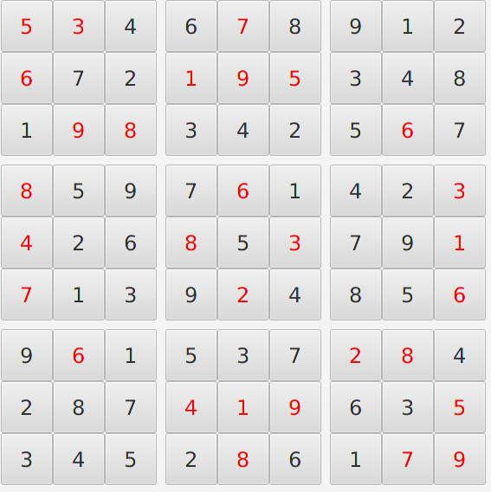
Solving a Sudoku
A branch should terminate immediately when it finds an infeasible configuration, and then explore the next branch.
After we have a branch that provides a feasible value to every cell, we have solved our Sudoku!
Unlike many optimization problems, Sudokus are trivial to solve because they constrain their search spaces quickly.

Slide 58
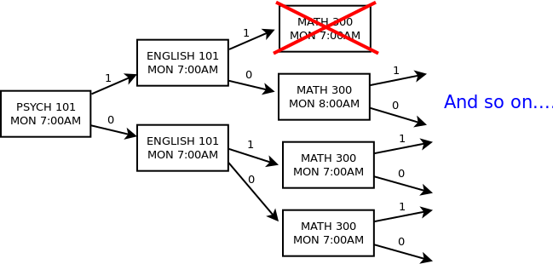
Branch-and-Prune for Scheduling
You could solve the scheduling problem from scratch with branch-and-prune.
Start with the most “constrained” slots first to narrow your search space (e.g. slots fixed to zero first, followed by Monday slots for 3-recurrence classes).
HINT: Proactively prune the tree as you go, eliminating any slots ahead that must be zero due to a “1” decision propagating an occupied state.

Slide 59
Generating a Schedule
If you want to schedule against multiple rooms, plot each variable using three dimensions.
MON 8:00
MON 8:15
MON 8:30
MON 8:45
MON 9:00
MON 9:15
MON 9:30
MON 9:45
PSYCH 300
1
0
0
0
MATH 300
PSYCH 101
1
0
0
0
ROOM 1
1
0
0
0
ROOM 2
1
0
0
0
ROOM 3

Slide 60
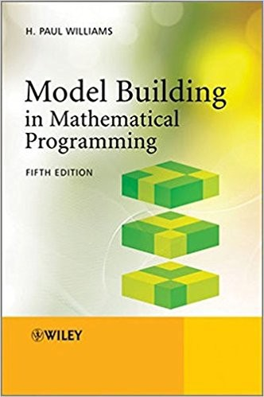
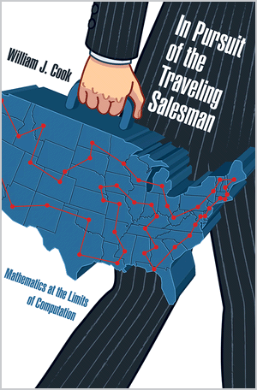
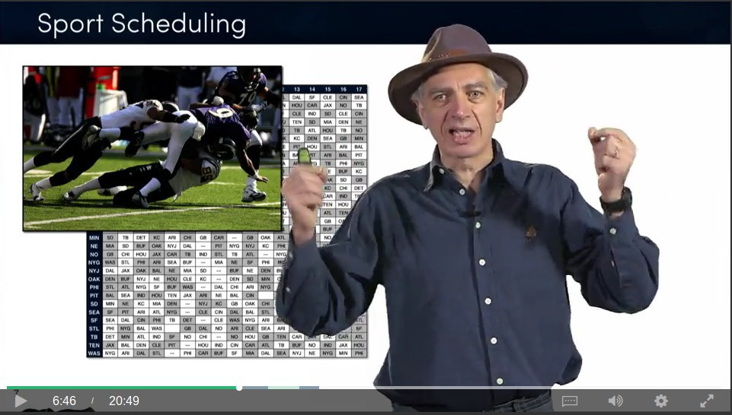
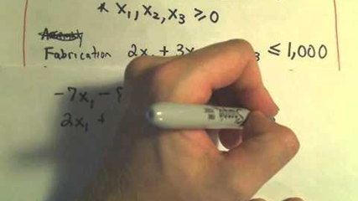
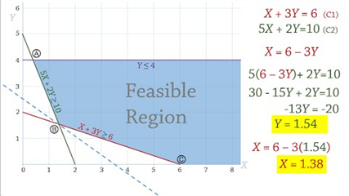

Learn More
PatrickJMT on YouTube
Joshua Emmanuel on YouTube
3Blue1Brown on YouTube

Slide 61
Classifying Things
Probably the most common task in machine learning is classifying data:
How do I identify images of dogs vs cats? What words are being said in a piece of audio? Is this email spam or not spam?
What attributes define high-risk, medium-risk, and low-risk loan applicants?
How do I predict if a shipment will be late, early, or on-time?
There are many techniques to classify data, with pros/cons depending on the task:
Neural Networks Support Vector Machines
Decision Trees/Random Forests Naive Bayes
Linear/Non-linear regression

Slide 62
Naive Bayes
Let’s focus on Naive Bayes because it is simple to implement and effective for a common task: text categorization.
Naive Bayes is an adaptation of Bayes Theorem that can predict a category C for an item T with multiple features F.
A common usage example of Naive Bayes is email spam, where each word is a feature and spam/not spam are the possible categories.

Slide 63
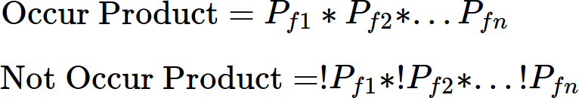
Implementing Naive Bayes
Naive Bayes works by mapping probabilities of each individual feature occurring/not occurring for a given category (e.g. a word occurring in spam/not spam).
A category can be predicted for a new set of features by…
1) For a given category, combine the probabilities of each feature occuring and not occuring by multiplying them.
2) Divide the products to get the probability for that category.

Slide 64
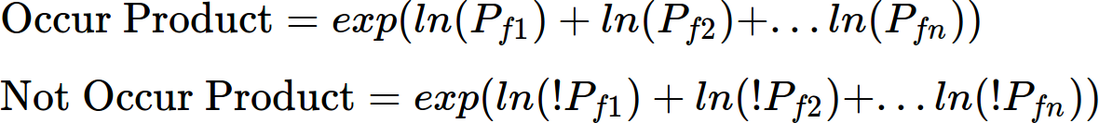
Implementing Naive Bayes
3) Calculate this for every category, and select the one with highest probability.
Dealing with floating point underflow.
A big problem is multiplying small decimals for a large number of features may cause a floating point underflow.
To remedy this, transform each probability with log() or ln() and sum them, then call exp() to convert the result back!

Slide 65
Implementing Naive Bayes
One last consideration, never let a feature have a 0 probability for any category!
Always leave a little possibility it could belong to any category so you don’t have 0
multiplication or division mess anything up.
This can be done by adding a small value to each probability’s numerator and denominator (e.g. 0.5 and 1.0).

Slide 66
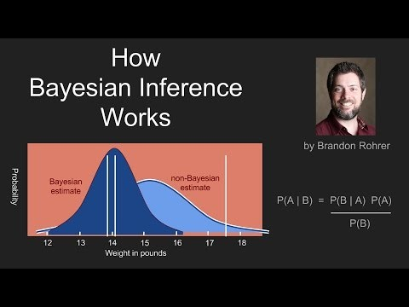

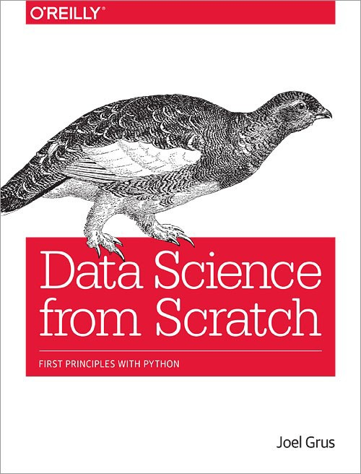
Learn More About Bayes
Brandon Rohrer - YouTube

Slide 67
Source Code
Bank Transaction Categorizer Demo https://github.com/thomasnield/bayes_user_input_prediction
Email Spam Classifier Demo https://github.com/thomasnield/bayes_email_spam

Slide 68








Part III:
Neural Networks

Slide 69







What Are Neural Networks?
Neural Networks are a machine learning tool that takes numeric inputs and predicts numeric outputs.
A series of multiplication, addition, and nonlinear functions are applied to the numeric inputs.
The mathematical operations above are iteratively tweaked until the desired output is met.

Slide 70
The Problem
Suppose we wanted to take a background color (in RGB values) and predict a light/dark font for it.
Hello
Hello
If you search around Stack Overflow, there is a nice formula to do this:
But what if we do not know the formula? Or one hasn’t been discovered?

Slide 71
A Simple Neural Network
Let’s represent background color as 3 numeric RGB inputs, and predict whether a DARK/LIGHT font should be used.
255
0
Hello
204
Mystery Math
1
Hello
204

Slide 72
A Simple Neural Network
255w₁+
204w₂+
204w₃
255
W₁
W₄
W
W
10
Multiply and sum again
2
Hello
W₃
255w₄+
204w₅+
204w₆
^{W}11
204
W₅
W
W
^{W}14
12
13
Multiply and sum again
Hello
W_{6 W}
7
W
8
255w +
W
7
204w₈+
204w₉
^{W}15
204
9

Slide 73
A Simple Neural Network
This is the “mystery math”
255w₁+
204w₂+
204w₃
255
W₁
W₄
W
W
10
Multiply and sum again
2
Hello
W₃
255w₄+
204w₅+
204w₆
^{W}11
204
W₅
W
W
^{W}14
12
13
Multiply and sum again
Hello
W_{6 W}
7
W
8
255w +
W
7
204w₈+
204w₉
^{W}15
204
9

Slide 74
A Simple Neural Network
Each weight w_{x} value is between -1.0 and 1.0
255w₁+
204w₂+
204w₃
255
W₁
W₄
W
W
10
Multiply and sum again
2
Hello
W₃
255w₄+
204w₅+
204w₆
^{W}11
204
W₅
W
W
^{W}14
12
13
Multiply and sum again
Hello
W_{6 W}
7
W
8
255w +
W
7
204w₈+
204w₉
^{W}15
204
9

Slide 75
A Simple Neural Network
Million Dollar Question:
What are the optimal weight values to get the desired output?
255w₁+
204w₂+
204w₃
255
W₁
W₄
W
W
10
2
1.0
Hello
W₃
255w₄+
204w₅+
204w₆
^{W}11
204
W₅
W₇
W
^{W}14
12
13
W
0.0
Hello
W_{6 W}
8
255w +
W
7
204w₈+
204w₉
^{W}15
204
9

Slide 76
A Simple Neural Network
Million Dollar Question:
What are the optimal weight values to get the desired output?
255w₁+
204w₂+
204w₃
255
W₁
W₄
W
W
10
2
1.0
Hello
W₃
255w₄+
204w₅+
204w₆
^{W}11
204
W₅
W₇
W
^{W}14
12
13
W
0.0
Hello
W_{6 W}
8
255w +
W
7
204w₈+
204w₉
^{W}15
204
9

Slide 77
A Simple Neural Network
Answer:
This is an optimization problem!
255w₁+
204w₂+
204w₃
255
W₁
W₄
W
W
10
2
.998
Hello
W₃
255w₄+
204w₅+
204w₆
^{W}11
204
W₅
W₇
W
^{W}14
12
13
W
.01
Hello
W_{6 W}
8
255w +
W
7
204w₈+
204w₉
^{W}15
204
9

Slide 78
A Simple Neural Network
We need to solve for the weight values that gets our training colors as close to their desired outputs as possible.
255w₁+
204w₂+
204w₃
255
W₁
W₄
W
W
10
2
.998
Hello
W₃
255w₄+
204w₅+
204w₆
^{W}11
204
W₅
W₇
W
^{W}14
12
13
W
.01
Hello
W_{6 W}
8
255w +
W
7
204w₈+
204w₉
^{W}15
204
9

Slide 79
Just like the Traveling Salesman Problem, you need to explore configurations seeking an acceptable local minimum.
Error Function
Weight Configurations

Slide 80
Stochastic gradient descent, simulated annealing, and
other optimization techniques can help tune a neural network.
Error Function
Weight Configurations

Slide 81
Activation Functions
RELU
SOFTMAX
You might also consider using activation functions on each layer.
255w₁+
204w₂+
204w₃
255w₄+
204w₅+
204w₆
255w₇+
204w₈+
204w₉
Multiply and sum again
Multiply and sum again
255
These are nonlinear functions that smooth, scale, or compress
the resulting sum values.
204
These make the network operate more naturally and smoothly.
204

Slide 82
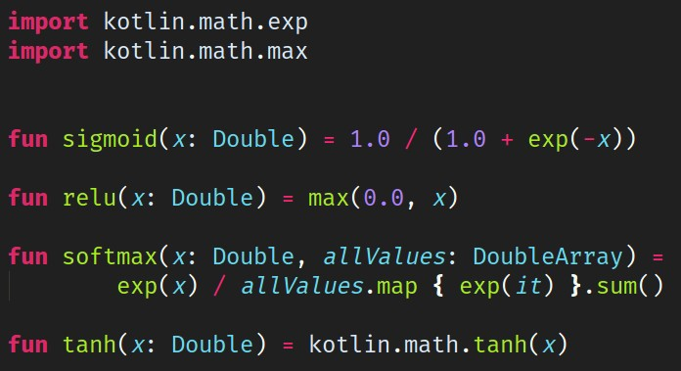
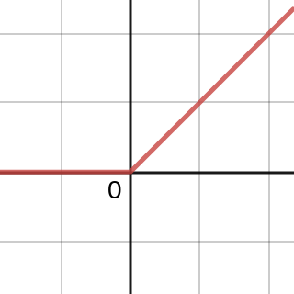
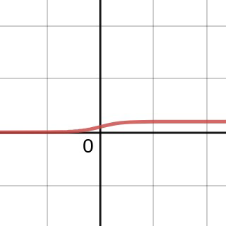
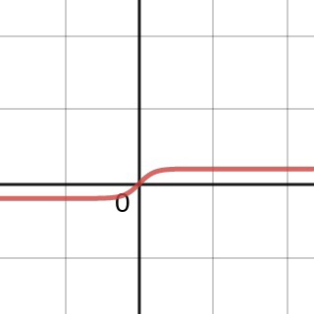
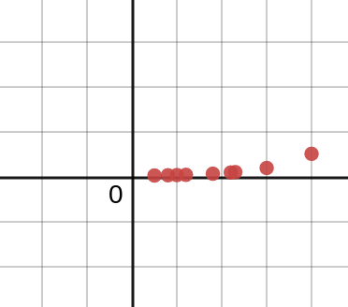
Activation Functions
Four common neural network activation functions implemented using kotlin-stdlib
RELU
SIGMOID
TANH
SOFTMAX
https://www.desmos.com/calculator/jwjn5rwfy6

Slide 83
Other Design Decisions
While optimizing weights is a core part of neural networks, there are other components to consider too:
How many middle layers are needed?
How many nodes are needed in each layer?
What activation functions should be applied to each layer?
Middle Layers - Should the layers be recurrent, recursive, convolutional, etc?
Loss function – How should we measure error?
Learning Rate - How aggressively should the optimization move towards the local minimum?

Slide 84
The Practicality of Neural Networks
Despite some seemingly intelligent applications like image recognition, neural networks have drawbacks:
Requires LOTS of labeled data for training.
Difficult for the data scientist to understand convoluted layers and nodes.
Has a quick diminishing return for problem spaces outside of image and natural language processing.
Neural networks generate excitement because many believe they will generalize solutions to most problems one day.
In reality, specialized and incumbent algorithms will outperform neural networks for most practical problems.
There are many academic papers citing research applying neural networks to the Traveling Salesman Problem and while this is interesting, the results are underwhelming.

Slide 85



Learn More About Neural Networks
3Blue1Brown - YouTube

Slide 86

Also Read My Recent Blog Article

Slide 87
Source Code
Kotlin Neural Network Example https://github.com/thomasnield/kotlin_simple_neural_network

Slide 88


P versus NP Problem
Another problem to be aware of in optimization and machine learning is the P versus NP problem.
If P = NP, that would mean solutions to hard problems (like optimization and machine learning) can be calculated just as quickly as they are verified.
While P = NP has been neither proven or disproven in the past 50 years, more scientists are coming to believe P does not equal NP.
This is a major limitation to the capabilities of machine learning and optimization, as it means complexity will always limit what we can do.
YouTube – The P versus NP Problem
The Traveling Salesman (2012 Thriller Film)

Slide 89
No Free Lunch Theorem
In machine learning and optimization, an unfortunate reality is you will need to customize models to every problem.
A given temperature schedule can work well with one Traveling Salesman Problem, but not as well with another.
A set of weights for one deep learning problem recognizing cats will not work with another recognizing dogs.
This is know as the no free lunch theorem, and because of it you should rarely expect a silver bullet implementation of any algorithm. You will always need to experiment with parameters and manually adapt to new situations.
https://en.wikipedia.org/wiki/No_free_lunch_in_search_and_optimization

Slide 90




Use the Right “AI” for the Job
Neural Networks
Bayesian Inference
Mathematical Optimization
●
Image/Audio/Video Recognition
“Cat” and “Dog” photo classifier
●
Text classification
Email spam, sentiment analysis, document categorization
●
Routing and Scheduling
Staff, transportation, classrooms, sports tournaments, server jobs
●
Natural language processing
●
Document summarization
●
On-Time Optimization
Transportation, manufacturing
●
Any fuzzy, difficult problems that have no clear model but lots of data Self-driving vehicles
Difficult nonlinear regressions Problems w/ mysterious unknowns
●
Probability inference Disease diagnosis, updating predictions
●
Industry
Manufacturing, farming, nutrition, energy, engineering, finance

Slide 91
Appendix

Slide 92
Pop Culture
Traveling Salesman (2012 Movie)
http://a.co/d/76UYvXd
Silicon Valley (HBO) – The “Not Hotdog” App
https://youtu.be/vIci3C4JkL0
Silicon Valley (HBO) – Making the “Not Hotdog” App
https://tinyurl.com/y97ajsac
XKCD – Traveling Salesman Problem
https://www.xkcd.com/399/
SOURCE: xkcd.com
XKCD – NP-Complete
https://www.xkcd.com/287/
XKCD – Machine Learning
https://xkcd.com/1838/

Slide 93
Areas to Explore
Machine Learning Linear Regression Nonlinear Regression Neural Networks
Bayes Theorem/Naive Bayes
Support Vector Machines Decision Trees/Random Forests K-means (nearest neighbor) XGBoost
Optimization
Discrete Optimization Linear/Integer/Mixed Programming Dynamic Programming
Constraint programming Metaheuristics

Slide 94
Online Class Resources
Coursera – Discrete Optimization
https://www.coursera.org/learn/discrete-optimization/home/
Coursera – Machine Learning
https://www.coursera.org/learn/machine-learning/home/welcome

Slide 95
YouTube Channels and Videos
Thomas Nield https://youtu.be/F6RiAN1A8n0
Brandon Rohrer https://www.youtube.com/c/BrandonRohrer
3Blue1Brown https://www.youtube.com/channel/UCYO_jab_esuFRV4b17AJtAw
YouTube – P vs NP and the Computational Complexity Zoo https://youtu.be/YX40hbAHx3s
The Traveling Salesman Problem Visualization https://youtu.be/SC5CX8drAtU
The Traveling Salesman w/ 1000 Cities (Video) https://youtu.be/W-aAjd8_bUc

Slide 96

Books

Slide 97
Interesting Articles
Does A.I. Include Constraint Solvers?
https://www.optaplanner.org/blog/2017/09/07/DoesAIIncludeConstraintSolv ers.html
Can You Make Swiss Trains Even More Punctual?
https://medium.com/crowdai/can-you-make-swiss-trains-even-more-punct ual-ec9aa73d6e35
The SkyNet Salesman
https://multithreaded.stitchfix.com/blog/2016/07/21/skynet-salesman/
97

Slide 98
Interesting Articles
Essential Math for Data Science
https://towardsdatascience.com/essential-math-for-data-science-why-and-how-e 88271367fbd
The Unreasonable Reputation of Neural Networks
http://thinkingmachines.mit.edu/blog/unreasonable-reputation-neural-networks
Mario is Hard, and that’s Mathematically Official
https://www.newscientist.com/article/mg21328565.100-mario-is-hard-and-thats- mathematically-official/
98

Slide 99
Interesting Papers
The Lin-Kernighan Traveling Salesman Heuristic
http://akira.ruc.dk/~keld/research/LKH/LKH-1.3/DOC/LKH_REPORT.pdf
The Traveling Salesman: A Neural Network Perspective
http://www.iro.umontreal.ca/~dift6751/paper_potvin_nn_tsp.pdf
The Interplay of Optimization and Machine Learning Research
http://jmlr.org/papers/volume7/MLOPT-intro06a/MLOPT-intro06a.pdf
99

